Slide 1
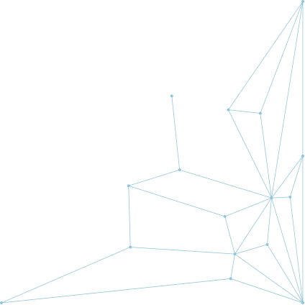
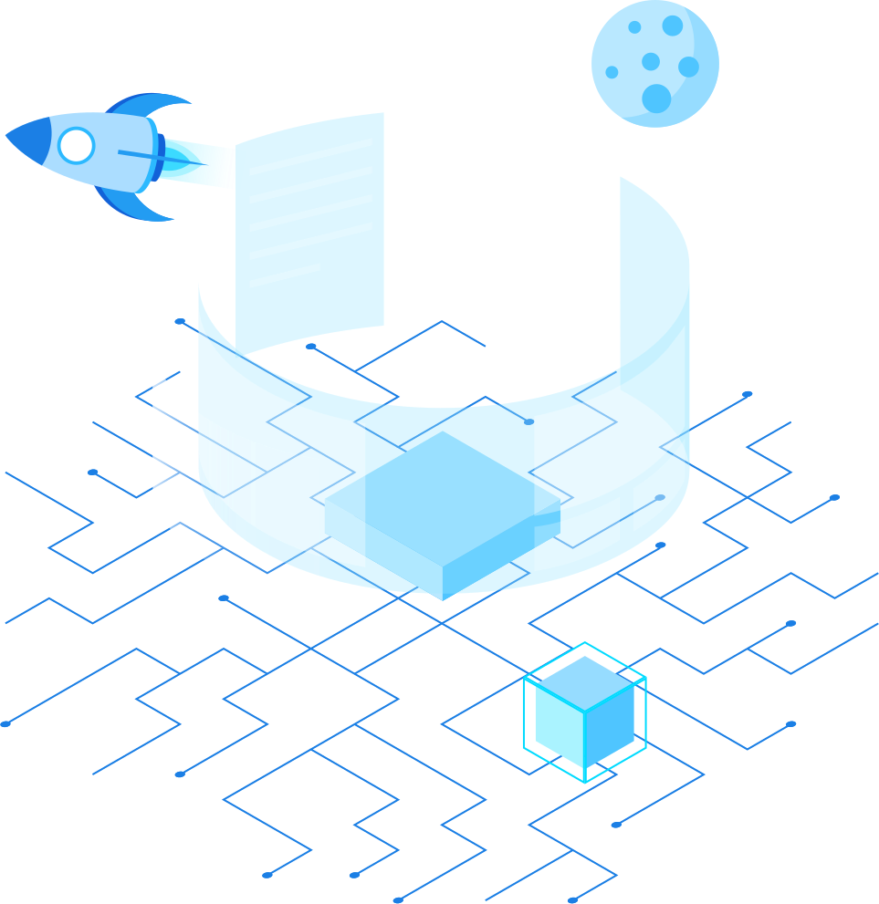

CLASSIFYING
NEURODEGENERATIVE DISEASES
By: Lubaina Malvi, Yining Tao, Yasmeen Dao, Willem Shak
Notes:
Hi everyone, Our project was on classifying neurodegenerative diseases by Lubaina, Yining, Yasmeen, and Willem

Slide 2



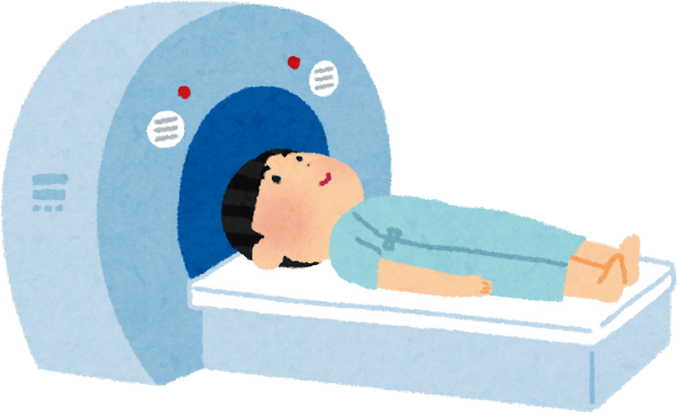
Goals
We aimed to perform multi-class classification on MRI scans of patients with healthy brains vs patients with neurodegenerative diseases such as Alzheimer’s and Parkinson’s.
Identify which areas of the brain have characteristics associated with certain neurodegenerative diseases
Answer questions like
Do multiple diseases exhibit in similar locations in the brain?
Do certain regions of the brain or shape of brain correlate to the diseases?
Notes:
For our project we aimed to perform muliclass classification on MRI scans of patients with healthy brains and patients with Alzheimer's and Parkinson's. We wanted to identify which areas of the brain have characteristics associated with certain neurodegenerative diseases, hoping to answer questions like do multiple diseases exhibit in similar locations in the brain and do certain regions of the brain or shape of it correlate to the diseases.

Slide 3

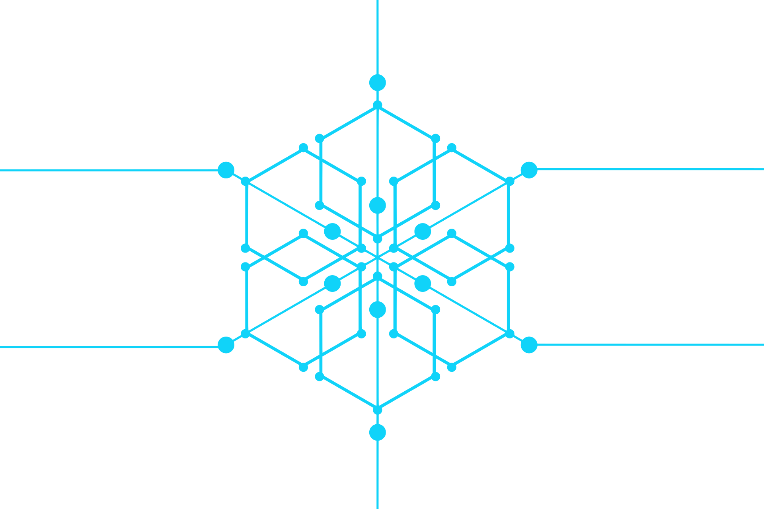
Our datasets
Kaggle dataset
Alzheimer’s - 2500 files
Normal - 2699 files
Parkinson’s - 2391 files
Huggingface Dataset
Alzheimers dataset - 6400 rows
Labels:
0 - mild demented
1 - moderate demented
2 - non demented
3 - very mild demented
Relabeled:
2 became normal
0,1,3 became alzhiemers
Notes:
We chose to use two datasets for this project. The first was a Kaggle dataset that had MRI scans of patients with Alzheimer's, Parkinson's, and normal brains.
The second dataset we had was from Huggingface and this one only had Alzheimer's with labels 0-3 ranking the level of the disease. We had to relabel these when we combined the two datasets.

Slide 4
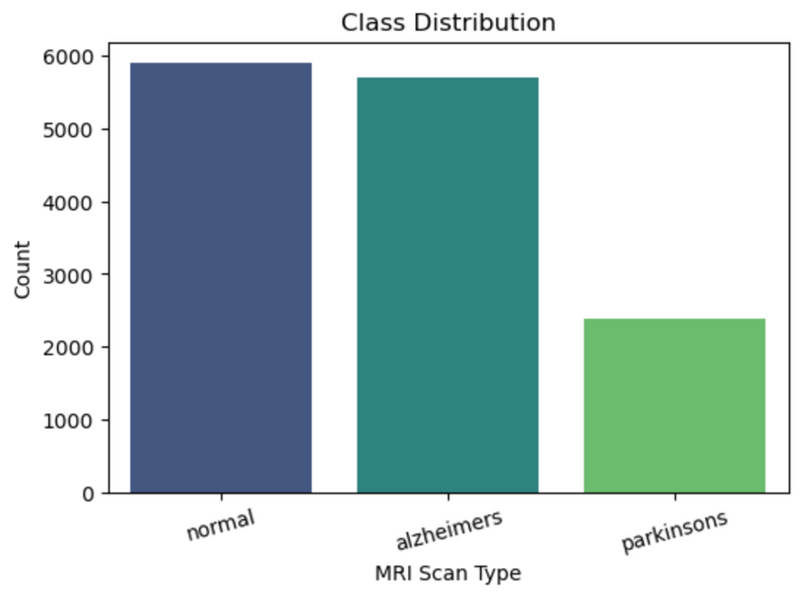
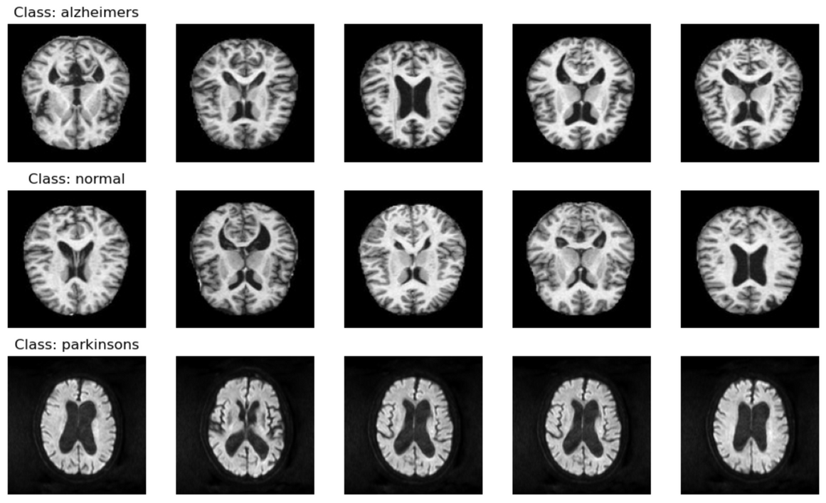
What is our data?
Parkinson’s had fewer images than the normal and Alzheimer’s because we used a second dataset that had just Alzheimer’s data
These are sample images from all of the classes that we are classifying between
Notes:
We plotted a class distribution bar chart for the combined dataset and saw that Parkinson's had significantly less data than Alzheimers which is due to the second dataset being Alzheimers and normal only which you can see on the bottom left. And on the bottom right are sample images from all three classes.

Slide 5
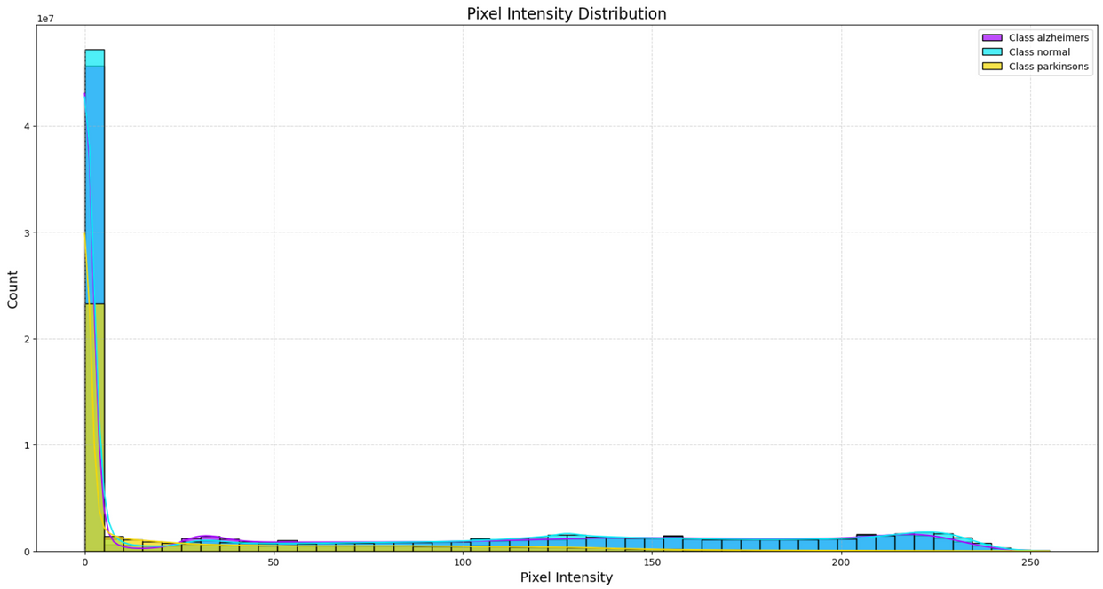
What is our data?
We also created a pixel intensity distribution
shows us that most of the pixels on of all the images were dark
the normal class had more lighter pixels than the others
tells us that the Parkinson’s images have a noticeable difference in terms of pixel intensity
The Parkinson’s data has less darkness than the other data

Slide 6
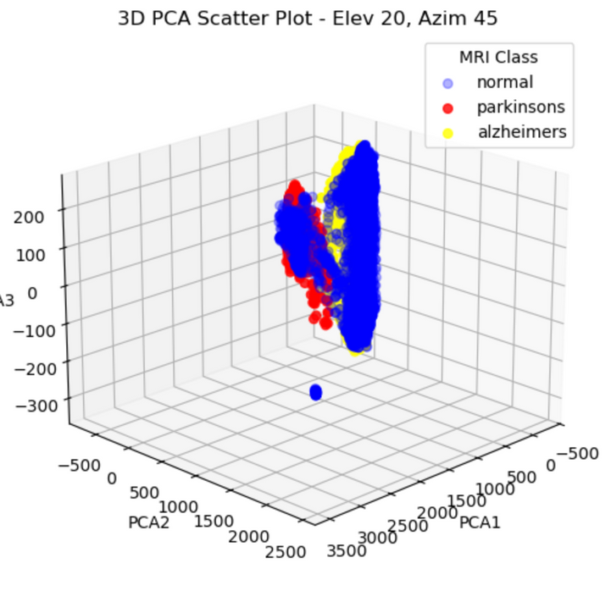
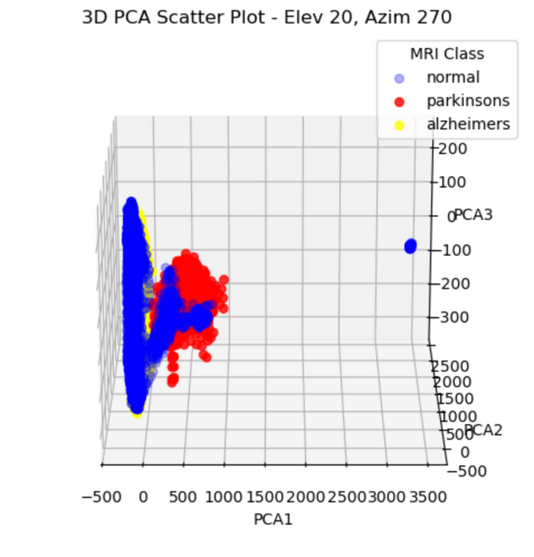
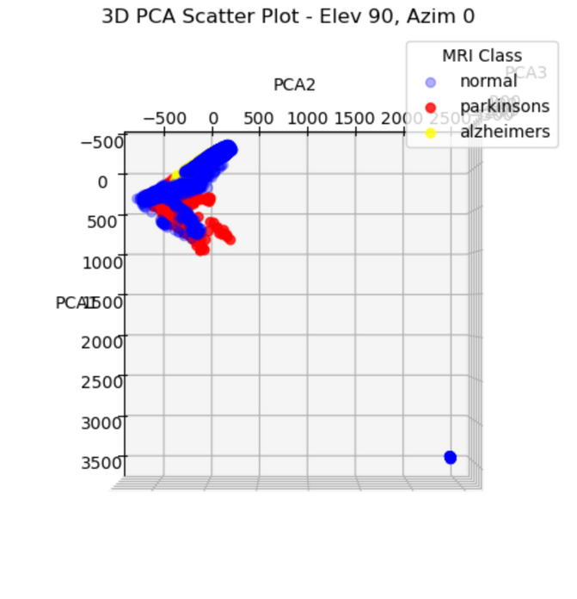
What is our data?
We also created 3D PCA scatter plots on the normalized and scaled data using the original data
clustered very close together but all separated into their own classes
this tells us that the data was inherently a little different between the classes

Slide 7
Dataset limitations
Diifficulties in finding medical data
Medical datasets are often restricted due to privacy concerns and regulatory limitations
We originally planned to include an additional neurdegenerative disease but couldn’t find structured MRI data that matched our existing datasets
Public datasets are often limited in size and diversity, making generalization harder
One of our very initial thoughts was “can we identify whether there are brain features that indicate a person is likely to develop the disease”
But again, there is not a lot of data containing brain scans of people’s brains before and after they developed a certain disease
Challenges with medical imaging data
MRI scans from different machines, hospitals, and protocols lead to inconsistencies in resolution, contrast, and noise level
These can introduce biases which can make training a model more challenging
Computational challenges
High resolution MRI images require significant memory and processing power
And training the models on the images was computationally expensive
Notes:
While working with this data we faced several limitations. First of all, medical datasets are often restricted due to privacy concerns and regulatory limitations. Also, MRi scans from different machines, hospitals, and protocols lead to inconsistencies within the data. And finally, the high resolution MRI images required significant memory and processing power.

Slide 8
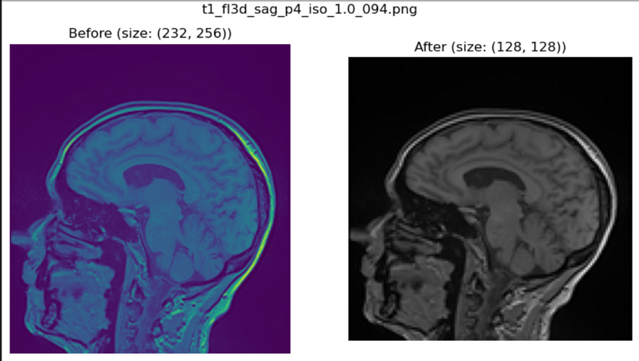

Combining Datasets and Preprocessing
The hugging face dataset had images in binary format, so we had to convert to images then to 2d np arrays
The Kaggle dataset had jpegs and pngs, we had to convert into 2d np arrays
Resize images to all be 128x128 and greyscale, some were as big as 540x470
The hugging face labels were 0-3 for severity of alzheimers, we classified 2 as normal, and 0, 1, 3 as alzheimers
Manually removed faulty images
Normalized the pixel values to be between 0 and 1
Image Resizing
Notes:
For preprocessing, both datasets had to be converted to 2D numpy arrays first. While the Kaggle dataset has image files, the huggingface has images in binary format so we had to convert those to images first. Next, we resized all of the images to be 128x128. Additionally, we had to relabel the huggingface data since that had ratings 0-3 for severity. We also removed faulty images and normalized the pixel values.

Slide 9
Preprocessing Mishap
We realized that our data was unbalanced after doing some model development
About 50% less Parkinson’s images than the other classes
We also wanted our model to be more generalizable
We ran some models with our original dataset, and...
Created a second dataset with augmented data
During training we randomly flip the images and rotate
We also oversample Parkinsons images because there are less data points
We’ll refer to those datasets as original and augmented because some experiments were ran before the augmented set
Notes:
During our experimentation we realized that our data was unbalanced and we decided we wanted our model to be more generalizable. After we has already trained some models with the original dataset, we created a second dataset with augmented data, meaning that during training, we randomly flip and rotate the images and oversample Parkinson's images because there are less data points for that. For the purpose of clarity, we will refer to the different datasets as original and augmented.

Slide 10
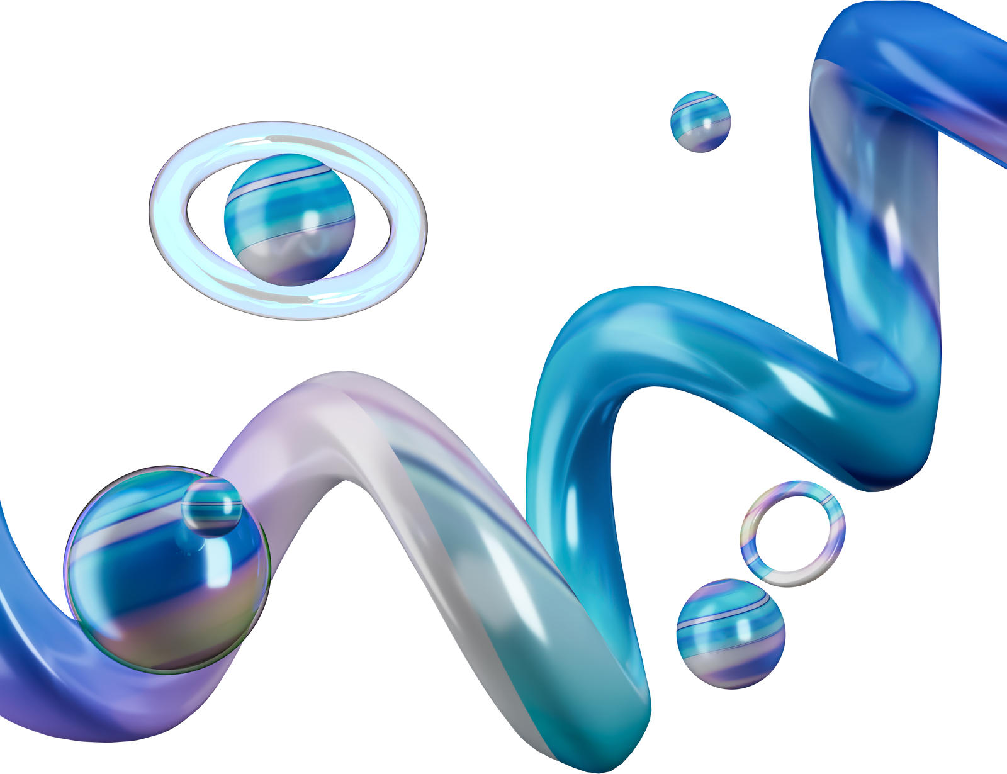

Feedforward Model - our baseline
Why we started with feedforward:
Simplicity
A good starting point before exploring more complex architectures
Baseline Model:
Served as our performance benchmark
Computational efficiency
faster training compared to CNN
For all our developed models:
We used cross entropy loss because it’s good for multi-class classification
We also made the output layer use softmax with 3 values
Architecture:
Flattened layer: takes in 128 x128 flattened MRI images (original dataset as input)
Three hidden layers: 512 neurons (ReLU) -> 256 neurons (ReLU) -> 128 neurons (ReLU)
Output layer: fully connected layer with soft-max activation for multi-class classification
Loss function: cross entropy loss : well suited for multi-class classification
Adam optimizer: effective for medical imaging since data can be unbalanced. learning rate 0.001
Notes:
We started with a feedforward neural network due to its simplicity. It provides a solid starting point before experimenting with more complex architectures and serves as a baseline model for performance comparison. Additionally, it is computationally efficient, allowing for faster training compared to convolutional neural networks. We also used cross entropy loss for all of our models because it's good for multi-class classification, we used adam optimizer because it's pretty standard and good, and our outputs use softmax.
Our architecture takes in 128x128 flattened MRI images as input.
The architecture details are listed below, but we are a bit short on time:
It consists of three hidden layers: the first with 512 neurons, followed by 256 and 128 neurons, all using ReLU activation. The output layer is a fully connected layer with a softmax activation function for multi-class classification.
To optimize training, we used cross-entropy loss, which is well-suited for multi-class problems. We also applied the Adam optimizer with a learning rate of 0.001—an effective choice for medical imaging tasks, especially when dealing with imbalanced datasets.

Slide 11
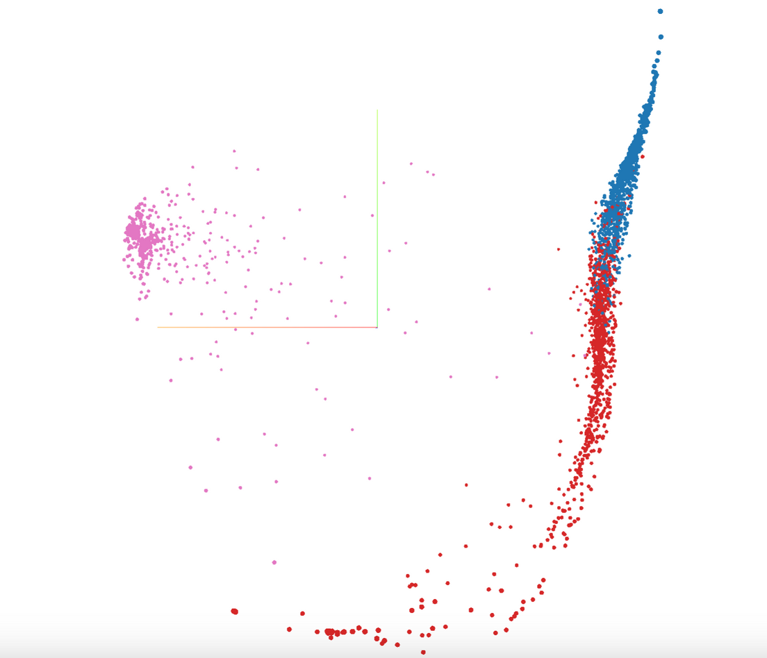
Feedforward v1 Results
Accuracy: 92.03%
Loss: 0.1961
Original Data
Tensor board with PCA for our feedforward network
pink - Parkinson’s
red - normal
blue - Alzheimer's
We can see Parkinson’s was clearly separated but there were a few Parkinson’s images that were close to the normal and Alzheimer’s
We can also see that Normal and Alzheimer’s had some overlap but majority was clustered separately
Notes:
"We trained our feed forward network on the original dataset, achieving an accuracy of 92.03% with a loss of 0.1961.
Looking at the TensorBoard visualization with PCA, we can see clear patterns in how the model classified different conditions. Parkinson’s cases (pink) were well-separated, though a few were close to the normal and Alzheimer’s clusters. Normal (red) and Alzheimer’s (blue) showed some overlap, but the majority of cases were separated.
____________________________________
This analysis highlights both the model's strengths and areas for improvement, particularly in distinguishing between normal and Alzheimer’s cases."

Slide 12
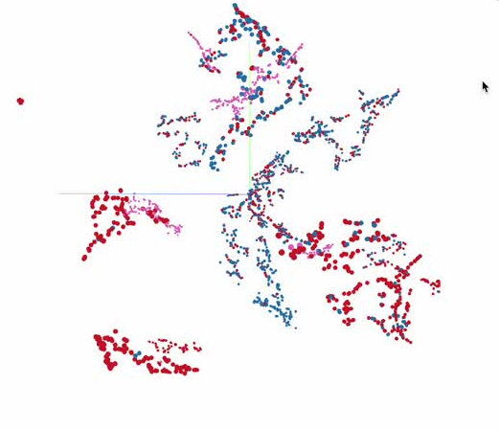
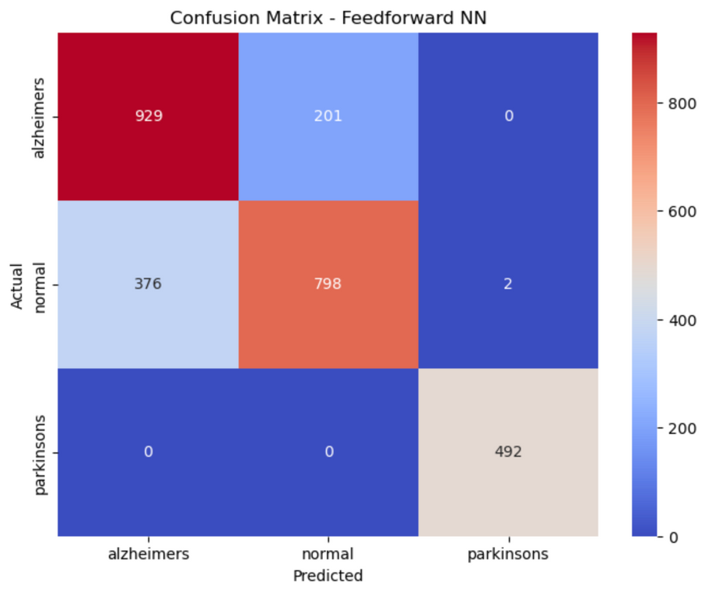
Feedforward model- 2nd iteration
Trained on augmented data
to increase generalization
got a baseline for the new augmented set of data
Achieved 77% accuracy, plateaued after 50 epochs
Architecture:
Same as baseline model, only changed inputs
Confusion matrix
misclassified normal and alzheimer's 201 and 376 times
misclassified normal for parkinson’s only twice
Notes:
Next we wanted to iterate on the feed forward network so we trained it on the augmented data, same architecture and everything. We were able to get 77% accuracy after 50 epochs, and we can see that it was very good at predicting parkinsons, which might mean that the parkinsons data was starkly different.

Slide 13
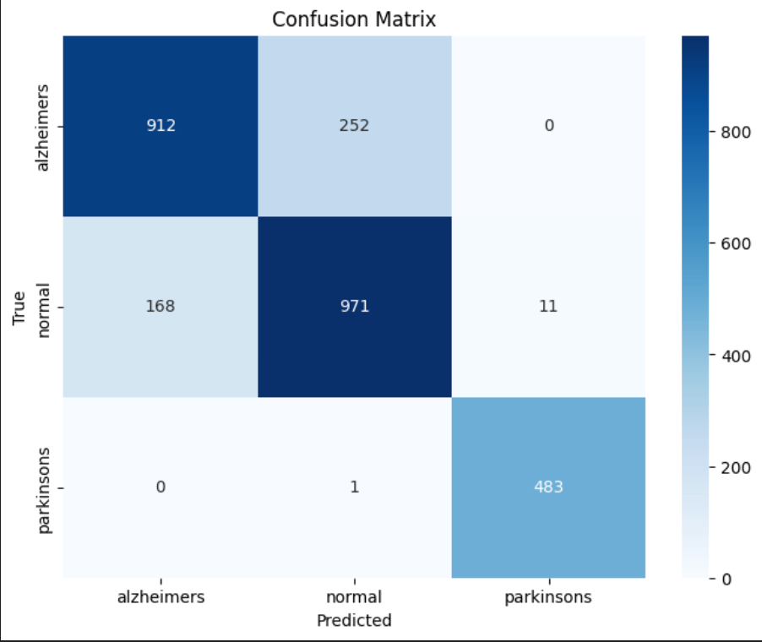
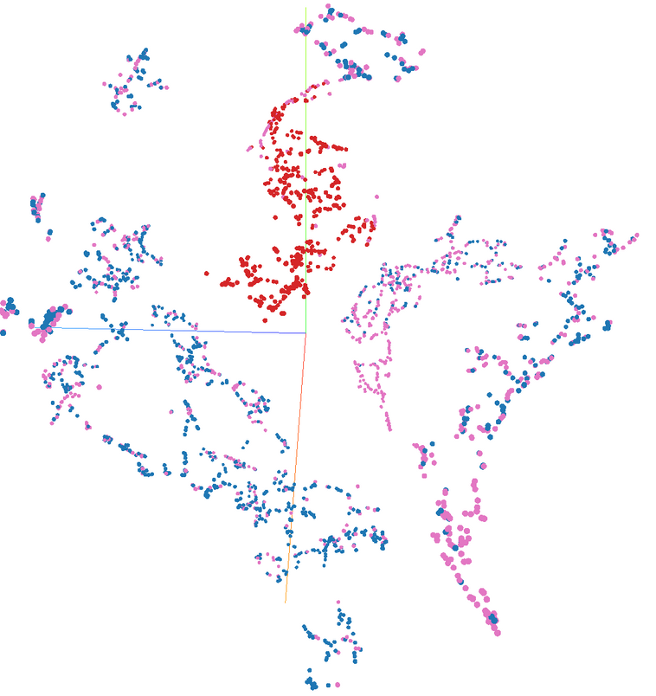
Feedforward model- 3rd iteration
Trained on augmented data
Achieved 82% accuracy, plateaued after 50 epochs
Architecture:
We added another hidden layer at the start from 1024->512 (before was 512), as well as batch normalization and dropout (0.3) between every hidden layer
Confusion matrix
misclassified normal and alzheimer's 168 and 252 times
misclassified normal for parkinson’s only 11 times
Notes:
We wanted to squeeze a little better performance out of our feed forward model, so we added another hidden layer at the start and batch normalization and dropout between layers, and this was able to achieve 82% accuracy after 50 epochs. This performed much better at predicting normal and alzheimers, but performed slightly worse than the last iteration at parkinsons.

Slide 14
CNN Model 1
Why Convolutional Neural Network - Original Data
Feedforward only achieved 82% accuracy, so we decided to move forward with CNNs which are known to learn spatial patterns in images better
Convolution and pooling layers detect features regardless of position
Already widely used for MRI analysis
Architecture:
Convolution + Pooling
Conv1: 32 filters 3x3 → ReLU → MaxPool (2×2)
Conv2: 64 filters 3x3 → ReLU → MaxPool (2×2)
Conv3: 128 filters 3x3 → ReLU → MaxPool (2×2)
Flatten Layer: Takes the output (128×16×16) and flattens to a 1D vector of 32768 features.
Fully Connected Layers
FC1: 128 neurons → ReLU
Output: Fully connected layer → raw logits for multi-class classification
Notes:
So next for our experimentation we wanted to try CNNs because they are well known for working well on images, and is even used on MRI image analysis a lot now.
The details of the architecture are listed below, but we have 3 layers of convolutions and we have one fully connected layer.

Slide 15
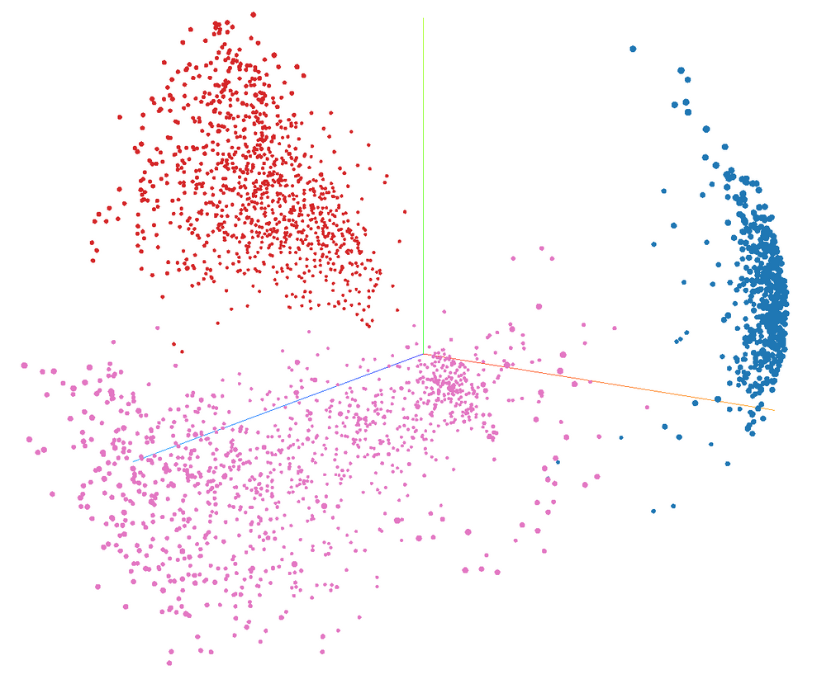

CNN Model 1 - Results
98% accuracy, albeit on unbalanced data
PCA on the last layer embeddings showed great class separation!
We thought exploring the kernels could be cool
initially started with 3x3 kernel size
they didn’t tell us much
Kernel Visualization 3/32 from first layer
Notes:
So with this model on the original data we were able to achieve 98% accuracy. We can see here in PCA that the last layer embeddings showed great clustering. Then we got inspired and though exploring kernel visualizations would be cool, but they were 3x3 so it didn't tell us much.

Slide 16
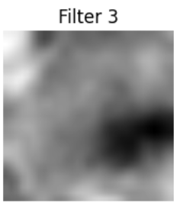
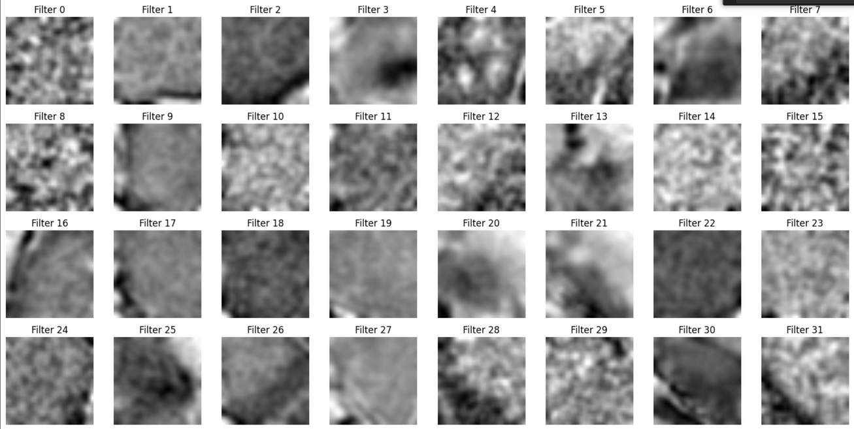
CNN Exploration - Big Kernels and Visualization
If we make big kernels, can we see some patterns?
We trained our CNN V1 again, 82% accuracy, except with 31x31 kernels
Visualized the kernels, and applied smoothing to make it more interpretable
Filter 3 looked like... something brainy?
Notes:
So then we thought if we can make huge kernels, could we see some patterns? So we trained our first CNN again except switched out the first kernels to be 31x31, and we visualized them and applied smoothing to make it more interpretable. We were able to see that filter 3 looked kinda brainy?

Slide 17
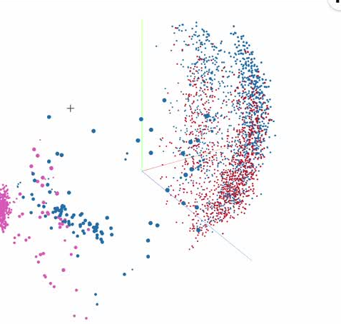
CNN Model 2
Trained CNN V1 on the augmented data,
Wanted better data for parkinsons, and wanted make the model more generalizable
Archtecture:
Same as CNN model one, we just changed the inputs
Achieved 90% accuracy after 30 epochs, plateaued
This is much better than feed forward on the augmented data!
With bettter data, the CNN performed worse
Notes:
So for our second CNN model we trained our first CNN on the augmented data, same architecture. This achieved 90% accuracy after 30 epochs. This did much better than the feed forward on the augmented data.

Slide 18
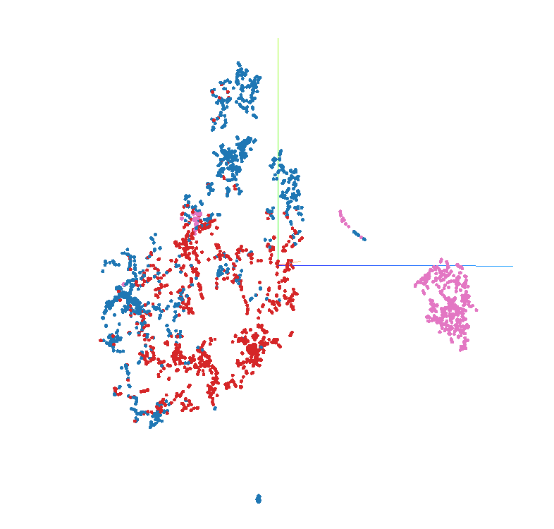
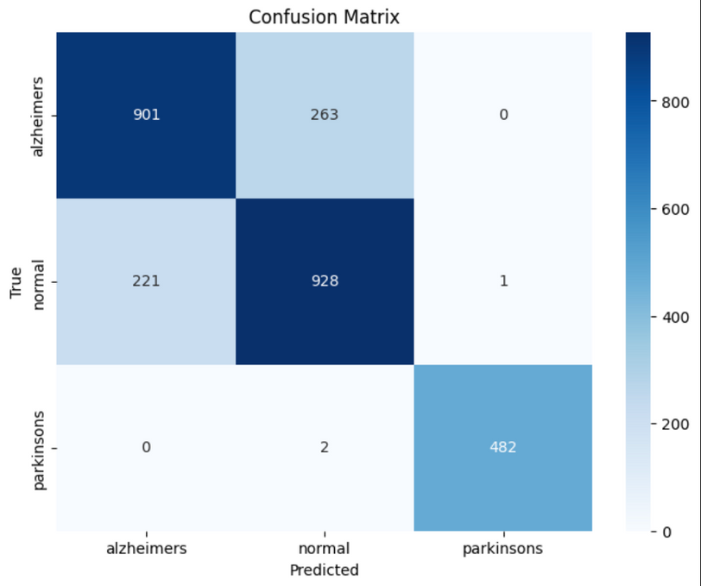
CNN Model 2 Results
When we look at embeddings in tsne, we can see it was able to easily cluster parkinsons, but had a bit of trouble differentiating normal and alzheimers
I think we’re learning that the parkinsons data isn’t great
Can see that this was also great at predicting parkinsons
Notes:
So jsut taking a look at the last layer embeddings we were able to easily cluster parkinsons, but there was a bit of trouble differentiating normal and alzheimers. I think we're learning parkinsos data isn't great

Slide 19
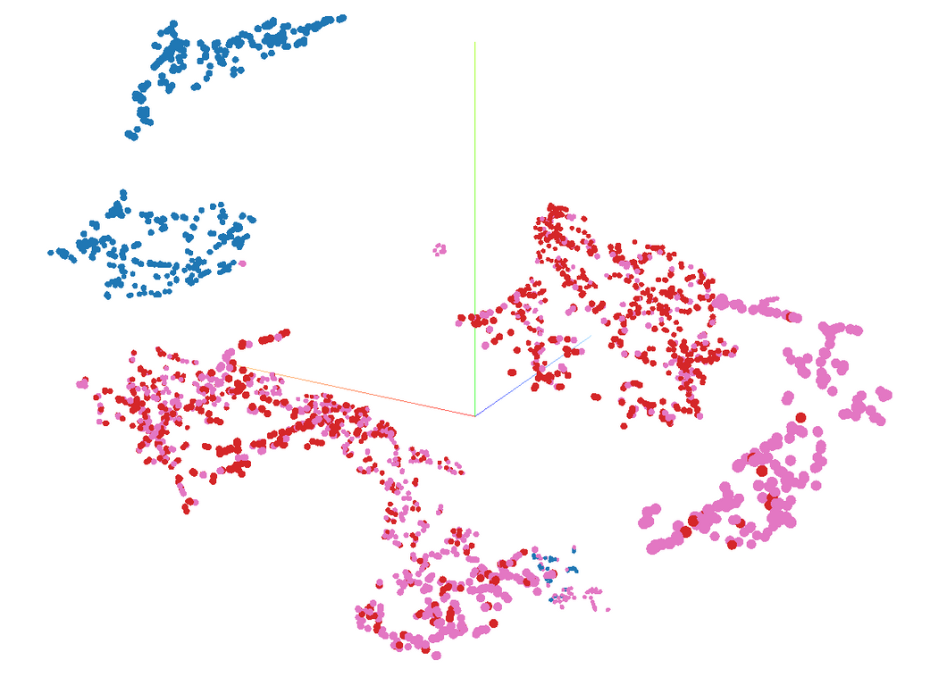
CNN Model 3
We took CNN Model 2 and added an additional convolutional layer (128-256), batch normilzation, hidden layer, as well as dropout(0.3)
After 100 epochs of training, it reached 80% accuracy and plateaued
Womp womp, we didn’t want to go down this route further
Notes:
So we wanted to take our CNN even further, sow e took that second CNN and added an additional convolutional layer, batch normalization, another hidden layer, and dropout. After 100 epochs it reached 80% accuracy. This didn't feel great so we didn't want to go down this route.

Slide 20
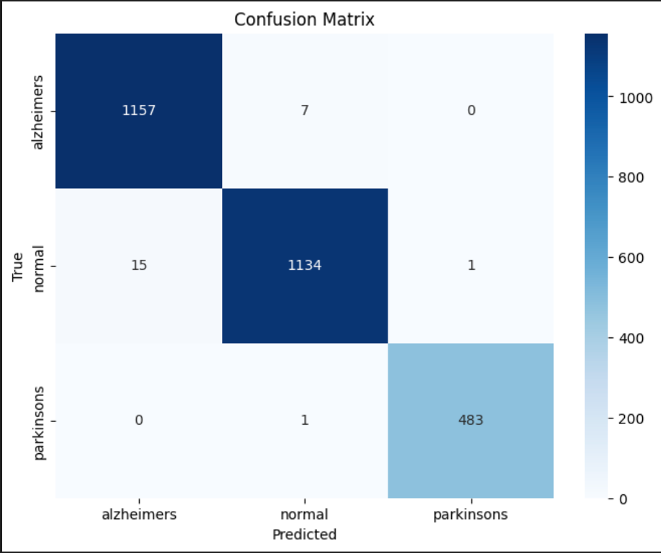
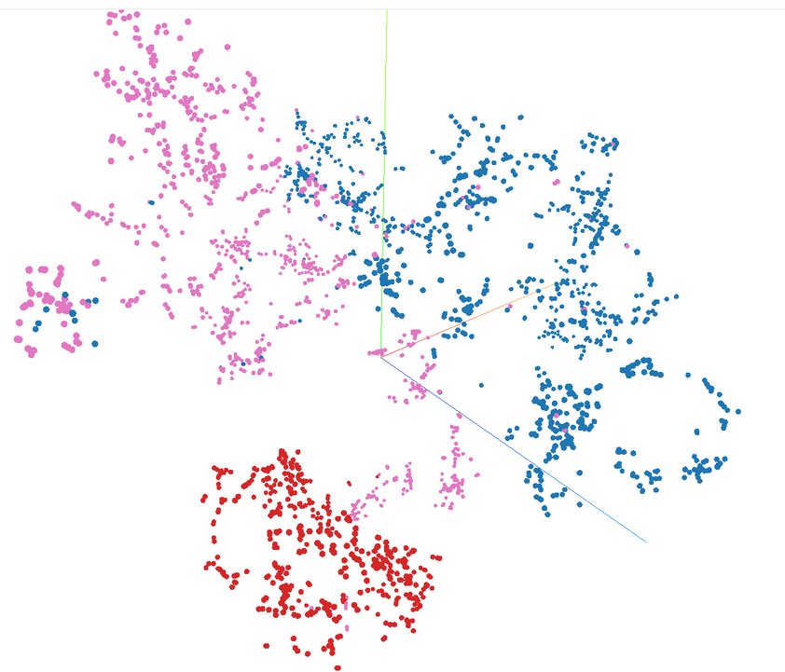
CNN Model 2- Fine Tuning
Fine tuned CNN V2 on the augmented data, and turned the learning rate down to e^-4
Achieved 98% accuracy after 100 more epochs of training
This the best result we got for the augmented data!
Notes:
Finally we decided to go back to our second CNN and fine tune it, so we turned down the learning rate to e^-4 instead of e^-3, and we got 94% accuracy after 50 more epochs of training. This was the best result we were able to get! THe embeddings look pretty clustered, and it rarely ever mispredicts alzheimers and normal

Slide 21
ResNet - Pre-trained
Why we utilized ResNet pre-trained model
Curious after CNN model 2 training on augmented data
Faster convergence/feature extraction
Already has learned features from other images
Easier to train - find patterns
Input
Single-channel grayscale images of the augmented data
Architecture:
ResNet18
Convolutional layer with 64 filters
7x7 kernal
Stride = 2
Padding = 3
Residual blocks with two convolutions for each block (help minimize vanishing gradients - help improve flow of information across layers helping to enhance model’s performance)
Fully connected layer
Notes:
We were curious after the CNN model 2 training on augmented data how a pre-trained model would compare as it has faster convergence/feature extraction and easier to train to find general patterns
We used ResNet18, for it's lighter architecture 64 filters, residual blocks, fully connected layer as the final output.

Slide 22
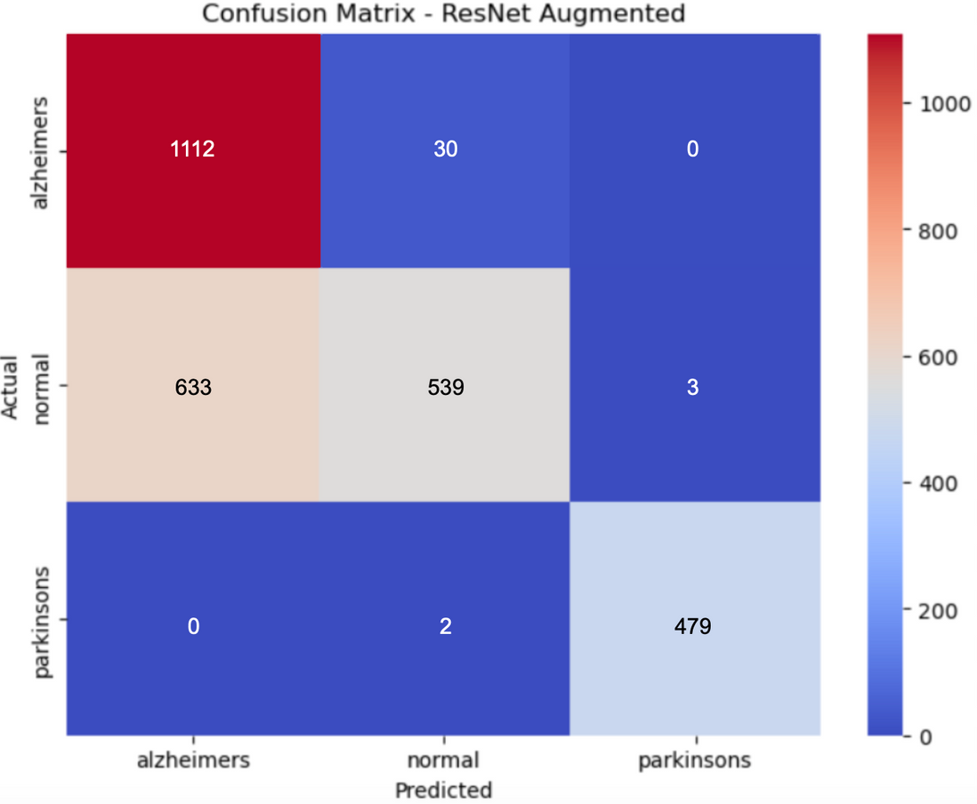
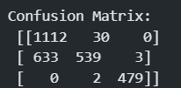
ResNet Results
ResNet on the augmented data performed 83%
Model often misclassifies Alzheimer’s and Normal MRI scans
Similar brain images
Parkinson’s was rarely misclassified
Notes:
For our results, model performed 83%.
Model often misclassifies Alzheimer’s and Normal MRI scans. Similar brain images
Parkinson’s was rarely misclassified.

Slide 23
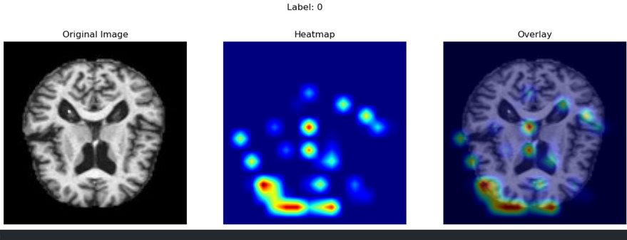
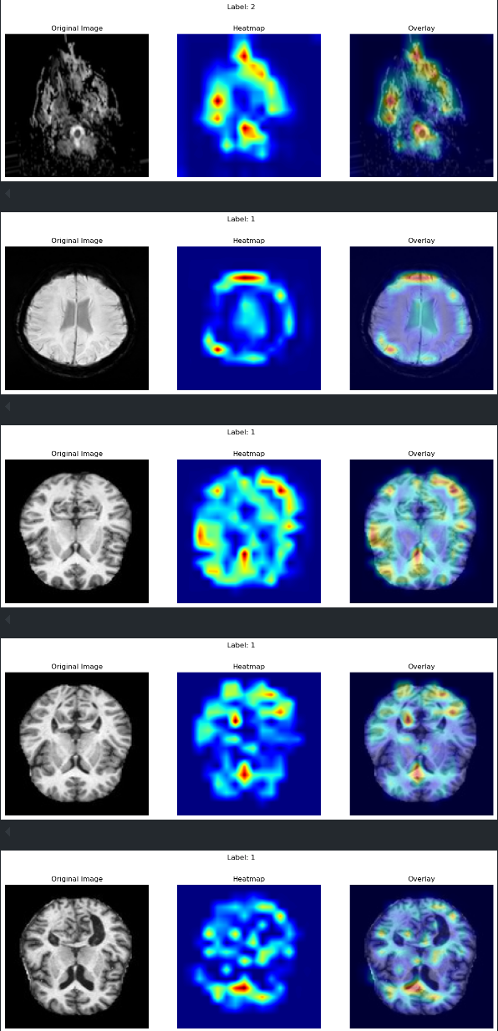
Grad-CAM
Why we used Grad-CAM:
Difficult to fully understand numeric values, helpful for visualization
Generated heat maps to highlight the important region of our brain images that contribute to the model prediction of a certain class
Interested in understanding which aspect of input image contributed to the model’s classification of the disease
Architecture:
Architecture of the previously mentioned CNN Model 2
Three conv layers
Two fully connected layers
Feature map storage
Use activations from last convolutional layer
Last layer contains representation of the most complex features the model learned to classify its inputs and is the most capable of helping us understand model’s behavior
Gradient storage (backprop)
Stores gradients during back propagation
Weighted Sum of Feature maps
Gradients stored are pooled to generate weights for each feature map in last conv layer
Weights represent the importance of each feature map to the predicted class, multiply each feature map by weight to get weighted sum
Weighted sum produces class activation map (heatmap) highlighting which regions of the image contributed most to the predicted class
Use ReLU activation to remove negative values to ensure only + contributing regions are shown
Overlay activation map onto input image to visualize important regions
Notes:
Gradient-Weighted Class Activation Mapping
We found it difficult to fully understand/visualize what the surface level numeric values told us so decided to implement Grad-CAM. Interested in understanding which part of the brain contributed to the model’s classification of the disease.
To implement we used the CNN Model 2 with the augmented data because it best classified the data without imbalance. We used the activations from last convolutional layer
because it contains representation of the most complex features the model learned to classify.
Then take the Weighted Sum of the Feature maps to produce the heatmap(activation map). Use ReLU activation to remove negative values to ensure only + contributing regions are shown
Overlay the heatmap onto input image to visualize important regions shown in image to the right.

Slide 24
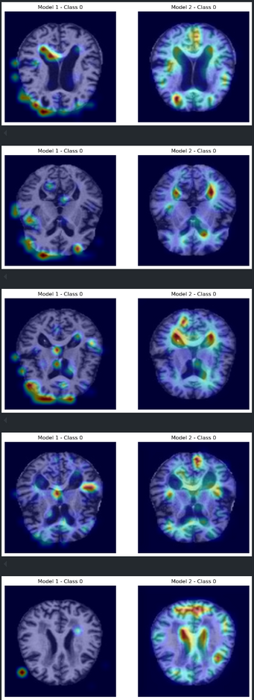
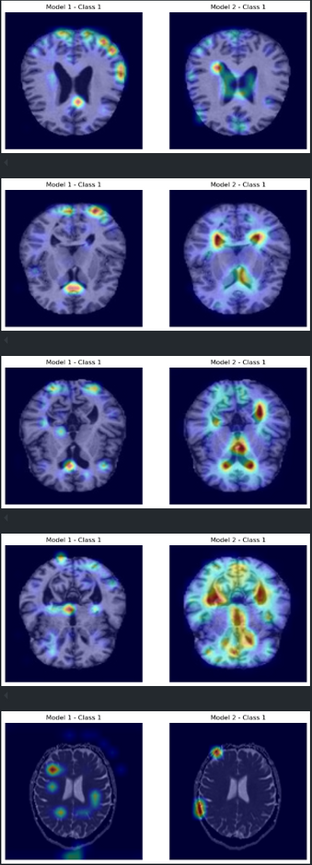
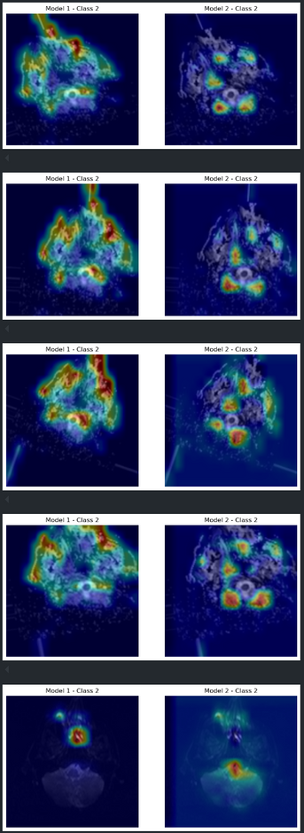
Grad-CAM - Results
Class 0:Alzheimer’s
Class 1:Normal
Class 2:Parkinson’s
Analysis
Original data left, augmented right
Colors indicate areas where model is focusing its attention on for classification
Red /yellow show high importance (indicating presence of disease)
Blue is lower importance
Model 2 has more detailed and specific highlighted regions of the MRI scan
Aligns with scientifically known regions that are affected (not expert in anatomy)
Alzheimer's- 3rd image (right side)
Hippocampus
Parkinson’s
Substantia nigra
Notes:
For our results we displayed the CNN 1 model with the original data on the left and the CNN2 with the augmented to showcase the difference in performance.
Red /yellow show high importance in determining classification.
Blue is lower importance. It's important to note that while the Normal category may have highlighted regions, this does not necessarily indicate the presence of disease. The highlighted areas simply show where the model is focusing to make its classification.
Overall shows Model 2 has more detailed and specific highlighted regions of the MRI scan.
Interestingly, we observed that the highlighted regions may align with scientifically known areas affected by these diseases, though we are not experts in anatomy. Alzheimer’s – In the third image (right side), the model appears to focus on the hippocampus, a region commonly associated with the disease.
Parkinson’s – The highlighted area seems to correspond to the substantia nigra at the bottom, which is known to be affected in Parkinson’s.

Slide 25
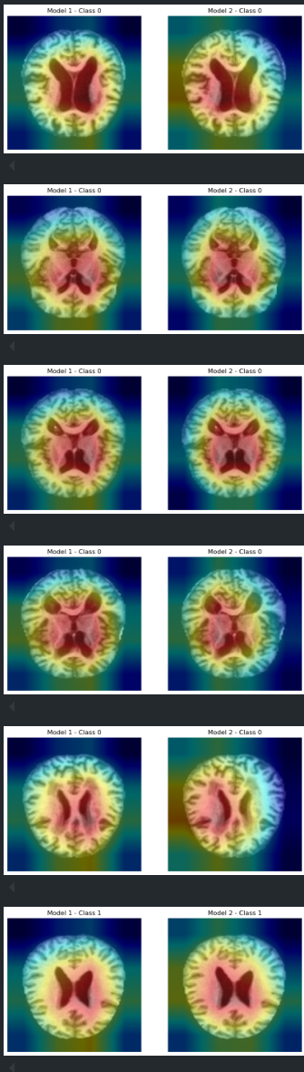
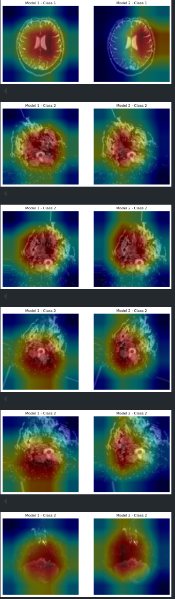
ResNet and Grad-CAM Results
Added Grad-CAM to our ResNet results
Heatmap displays an overgeneralization across the MRI images
Relying more on broader patterns versus specific regions
Misses out on the finer details
Notes:
Also, applied grad-cam to res-net to see if there were similar patterns in identification. We found that the heatmap displays an overgeneralization across the MRI images
Relying more on broader patterns versus specific regions
Misses out on the finer details.

Slide 26
Takeaways
Many limitations with medical data and computational power
CNN with augmented data performed the best while Feed-Forward and ResNet performed worse with that data
Custom CNN vs Baseline/Pre-trained
Grad Cam has a lot of potential to visualize locations in the brain that indicate disease
But requires a lot of training
Notes:
Some takeaways we had form this project were that first of all, there are many limitation when working with medical data. Additionally, we found that the CNN with the augmented data performed the best while the feed-forward and ResNet performed the worst with the same data. and finally, Grad cam has a lot of potential for visualizing locations in the brain that indicate disease.

Slide 27

Future Extensions
The scope of our study could be expanded
We can potentially do early disease prediction by training models to detect pre-disease indicators and progression patterns in MRI scans
Provided we are able to obtain datasets with information on patients as they were in the process of developing neurodegenerative diseases
We could also incorporate multi modal learning
By combining MRI scans with other medical data such as genetic markers and clinical history for better prediction beyond just looking at an MRI scans
We could explore more advanced architectures
Vision Transformers
Combine CNNs with RNNs or LSTM
Notes:
And finally we were thinking about future extensions of this project. One possibility is that we could do early disease prediction given data of patients with different progression of the diseases. We could also incorporate multimodal learning combining data like genetic markers and clinical history. And finally we could also explore more advanced architectures like vision transformers or combine CNNs with RNNs or LSTMs

Slide 28
Thank you!

